Slide 1
CHGM-141
General and Analytical Chemistry I
Lecture 14(a)
(Ch.6)
with Dr. Bailey
Mole,
MOLAR MASS
Molecular Weight and Molar mass

Slide 2
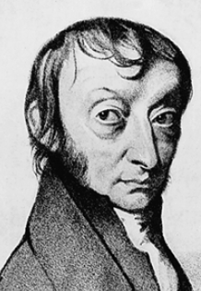
Particles in a Mole
What we know….
Avogadro’s Number
Amedeo Avogadro
1776-1856
6.02214199 x 10²³
There is Avogadro’s number of particles in a mole of any substance.

Slide 3
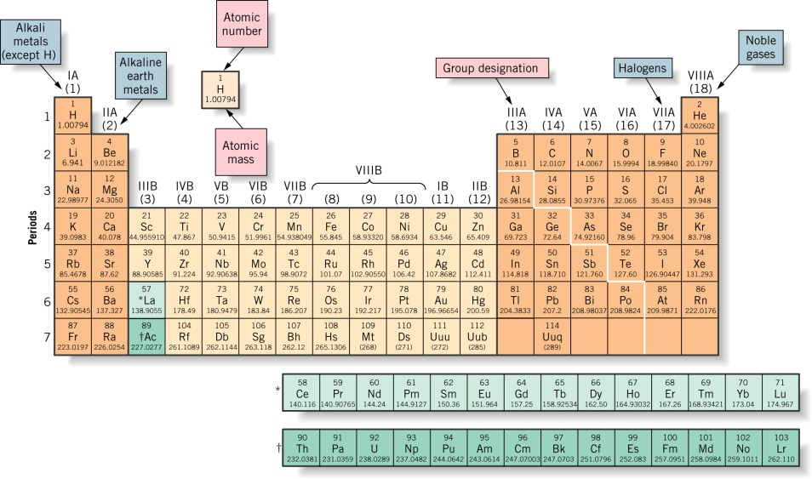
Molar Mass
What we know….
The mass in grams of one mole of any element (6.0221415x10²³ atoms) is the molar mass of that element
An element’s molar mass is the amount in grams numerically equal to its atomic weight.

Slide 4

What is molar mass of :
Carbon?
Oxygen (atoms)?

Slide 5
Building Molecules
Consider carbon dioxide – CO₂
It’s just like a little house made out of different size bricks
C
O
O

Slide 6
Pieces of the Whole
If you look at the molecule this way, it is easy to see how the number of parts relates to the whole thing
C
O
O

Slide 7
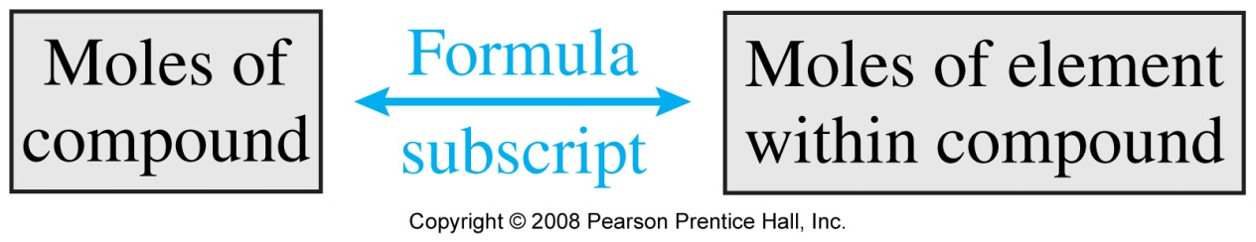
What is the molar mass of carbon dioxide CO₂
C
O
O
1 mol of this compound contains:
1 mol C (12.01 g C/1 mol) = 12.01 g C
2 mol O (16.00 g O/1 mol) = 32.00 g O
TOTAL = molar mass = 44.01 g/mol

Slide 8
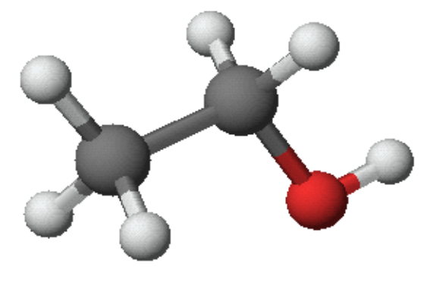
What is the molar mass of ethanol, C₂H₆O?
1 mol contains
2 mol C (12.01 g C/1 mol) = 24.02 g C
6 mol H (1.01 g H/1 mol) = 6.06 g H
1 mol O (16.00 g O/1 mol) = 16.00 g O
TOTAL = molar mass = 46.08 g/mol

Slide 9
Another Way …..
MOLECULAR WEIGHT AND MOLAR MASS
Molecular weight = sum of the atomic weights of all atoms in the molecule.
Molar mass = molecular weight in grams
To determine the molar mass of a molecule, you can simply add together the atomic masses of the atoms that make it up.

Slide 10
MOLAR MASS
(Example)
For MgO:
1. Molar Mass of MgO = Molar mass of Mg + Molar Mass of O
= 24.31 g/mol + 16.00 g/mol
= 40.31 g/mol
Or …
2. To determine the molar mass of a molecule, you can simply add together the atomic masses of the atoms that make it up.
Molecular Weight of MgO = 24.31 amu + 16.00 amu =
= 40.31 amu
Molar Mass of MgO = 40.31 g/mol

Slide 11
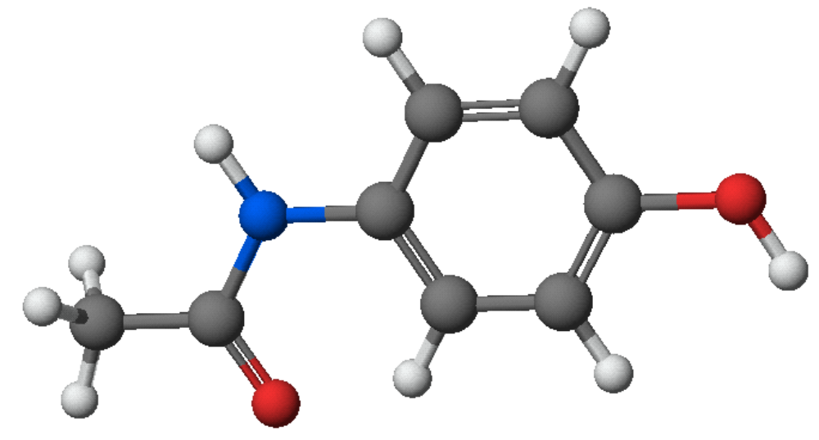
Tylenol
Formula =
Molar mass =
C₈H₉NO₂
151.2 g/mol

Slide 12
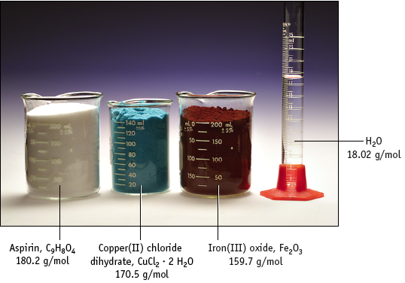
Molar Mass

Slide 13
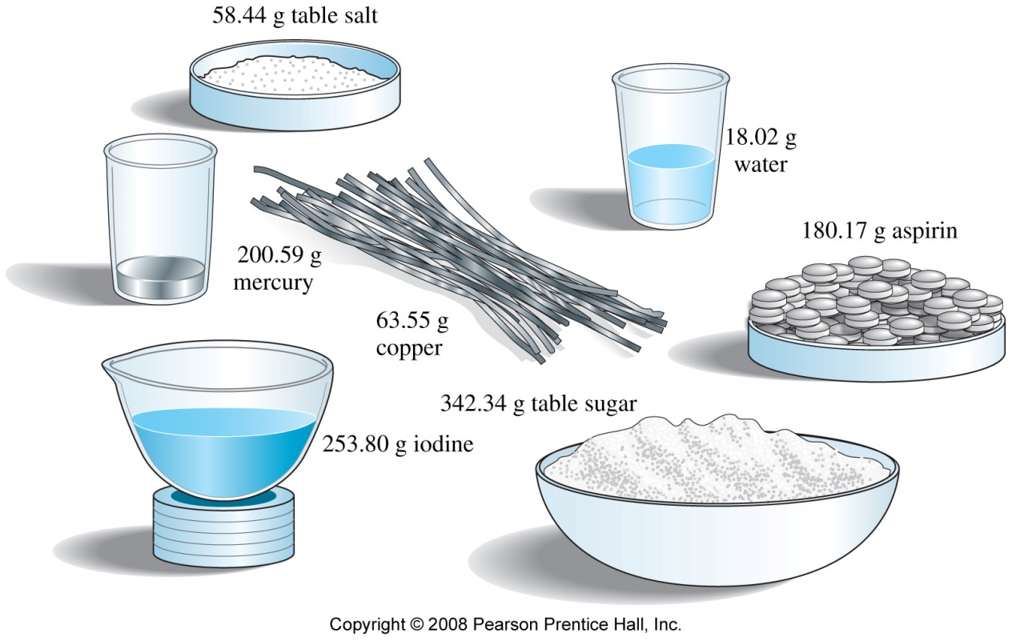

Slide 14
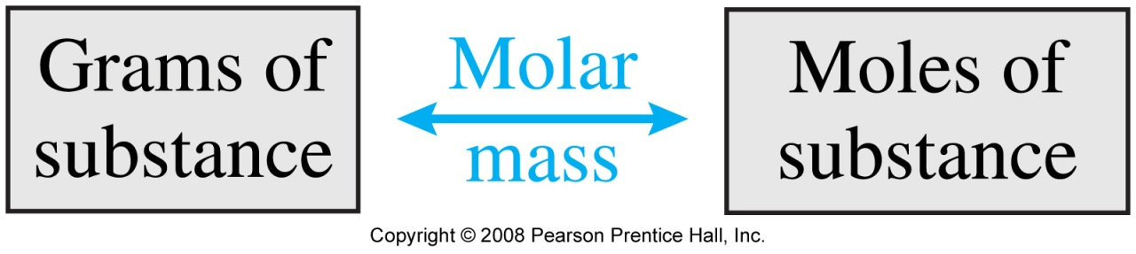
Very common calculation
We will constantly be calculating the number of moles of chemical compounds. We will see many more examples throughout the course.
Applying the molar mass is the most common calculation, and it is easy to do once you have the chemical formula (for example H₂O) which indicates the number of each atom.

Slide 15
Sample Problem
I have 36.45 g of water (H₂O), how many moles of water is that?
1. What do you know?
g of water
2. What do you want to know?
moles of water
3. What do you need to know?
molar mass of water

Slide 16
Sample Problem
I have 36.45 g of water (H₂O), how many moles of water is that?
To get the molar mass of water…
…add up the molar masses of each atom
Molar mass H₂O = 2*mass of hydrogen + 1 mass of oxygen

Slide 17
Sample Problem
I have 36.45 g of water (H₂O), how many moles of water is that?
Molar mass H₂O = 2*mass of hydrogen + 1 mass of oxygen
= 2*(1.00797 g/mol) + 16.000 g/mol
=18.016 g/mol

Slide 18
Solution
I have 36.45 g of water (H₂O), how many moles of water is that?
36.45 g H₂O * 1 mol H₂O = 2.023 mol H₂O
18.016 g H₂O

Slide 19
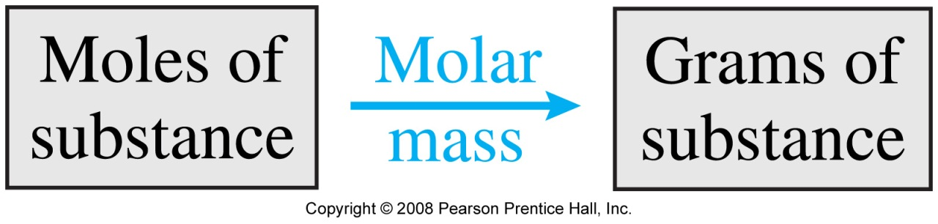
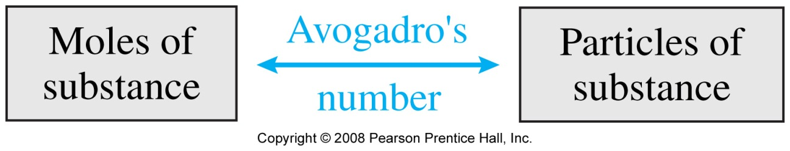
Very common calculation

Slide 20
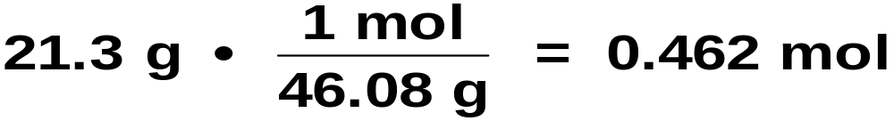
How many moles of alcohol C₂H₆O are there in a “standard” can of beer if there are 21.3 g of C₂H₆O?
(a) Molar mass of C₂H₆O = 46.08 g/mol
(b) Calc. moles of alcohol

Slide 21
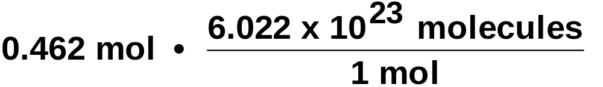
How many molecules of alcohol C₂H₆O are there in a “standard” can of beer if there are 21.3 g of C₂H₆O?
We know there are 0.462 mol of C₂H₆O.
= 2.78 x 10²³ molecules

Slide 22
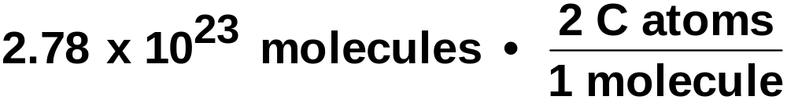
How many atoms of C are there in a “standard” can of beer if there are 21.3 g of C₂H₆O?
There are 2.78 x 10²³ molecules.
Each molecule contains 2 C atoms.
Therefore, the number of C atoms is
= 5.57 x 10²³ C atoms

Slide 23
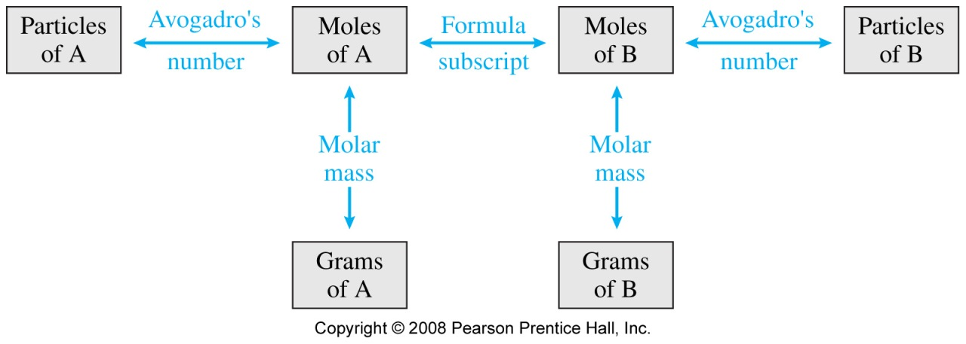
Very common calculation
Chemical Composition
A_{x}B_{y}
(g, mol)
We will come back to Chemical Composition later

